Slide 1


Slide 2
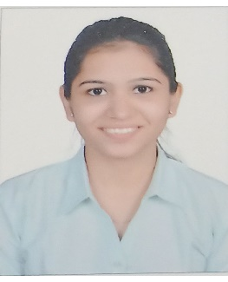
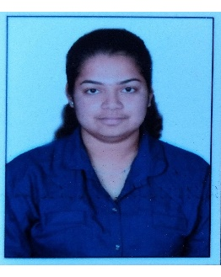

Project Highlights
Project Name : Scientific Calculator
Team Size : 3
BU Mentor Name : Milind Hatkhamkar, Pradeep Tunga Mentor PS#
Shweta Melavane
PS#99002488
2009BLRICP01
B.Tech, EXTC
Time Management, Teamwork
Akshata Chandrakant Shet
PS#99002465
2009BLRICP01
BE (EXTC)
Team Worker, Leadership qualities, Quick learner
Roshan Kochgawe
PS#99002461
2009BLRICP01
B.Tech, EEE
Motivator, Punctual

Slide 3
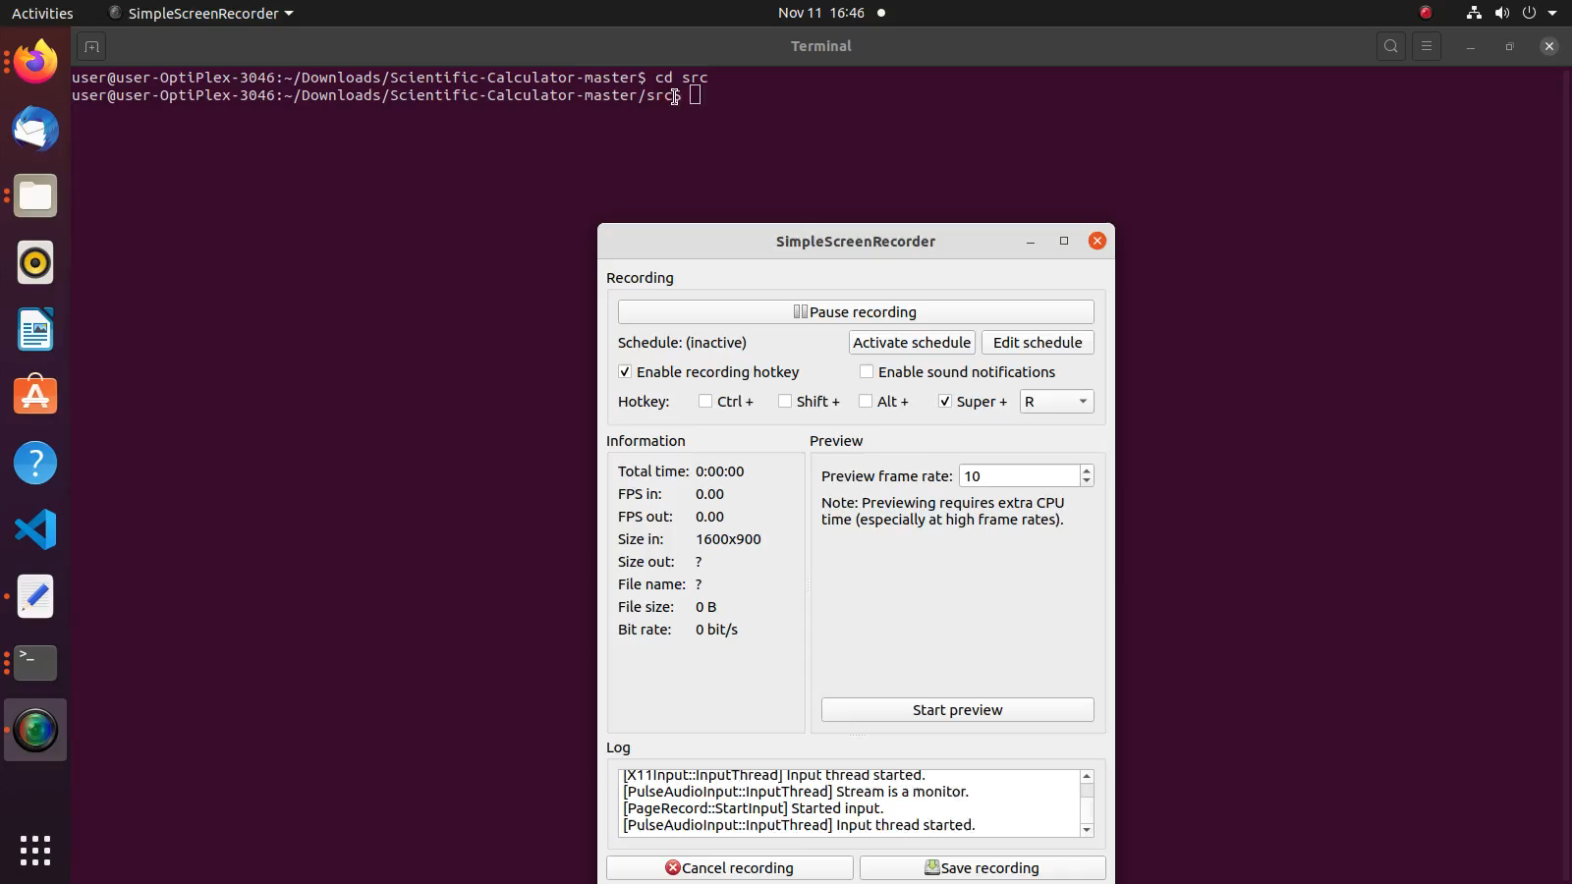
Project Video Snippet

Slide 4
Future development that can be implemented further
More scientific functions can be added.
Overall layout can be improved.

Slide 5


Thank You !

